Slide 1
Exception Handling

Slide 2
Exception Handling in Java
The exception handling in java is one of the powerful mechanism to handle the runtime errors so that normal flow of the application can be maintained.

Slide 3
What is exception
Exception is an abnormal condition.
In java, exception is an event that disrupts the normal flow
of the program. It is an object which is thrown at runtime.
What is exception handling
Exception Handling is a mechanism to handle runtime errors such
as ClassNotFound, IO, SQL etc.

Slide 4
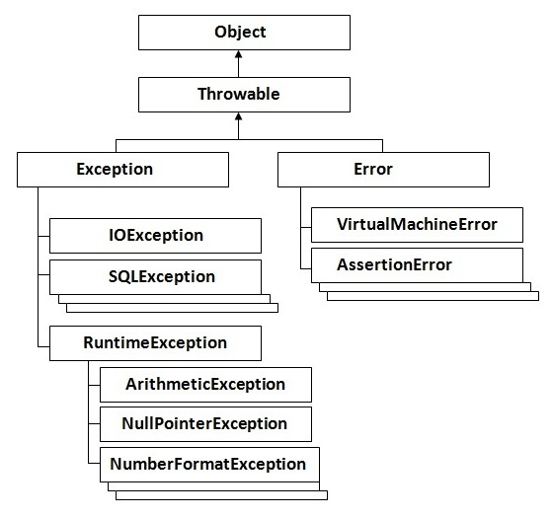
Hierarchy of Java Exception classes

Slide 5
Types of Exception
There are mainly two types of exceptions: checked and unchecked where error is considered as unchecked exception.
The sun microsystem says there are three types of exceptions:
Checked Exception
Unchecked Exception
Error

Slide 6
1) Checked Exception
The classes that extend Throwable class except RuntimeException and Error are known as checked exceptions e.g.IOException, SQLException etc. Checked exceptions are checked at compile-time.
2) Unchecked Exception
The classes that extend RuntimeException are known as unchecked exceptions e.g. ArithmeticException, NullPointerException, ArrayIndexOutOfBoundsException etc. Unchecked exceptions are not checked at compile-time rather they are checked at runtime.
3) Error
Error is irrecoverable e.g. OutOfMemoryError, VirtualMachineError, AssertionError etc.

Slide 7
Java Exception Handling Keywords
There are 5 keywords used in java exception handling.
try
catch
finally

Slide 8
Java try block
Java try block is used to enclose the code that might throw an exception.
It must be used within the method.
Java try block must be followed by either catch or finally block.
Syntax of java try-catch
Syntax of try-finally block
try{
//code
}
catch(Exception_class_Name ref)
{
}
try{
//code
}finally
{
}

Slide 9
Java catch block
Java catch block is used to handle the Exception. It must be used after the try block only.
You can use multiple catch block with a single try.
Ex:-
public class Testtrycatch2
{
public static void main(String args[]){
try
{ int data=50/0; }
catch(ArithmeticException e)
{System.out.println(e);}
System.out.println("rest of the code..."); }
}

Slide 10
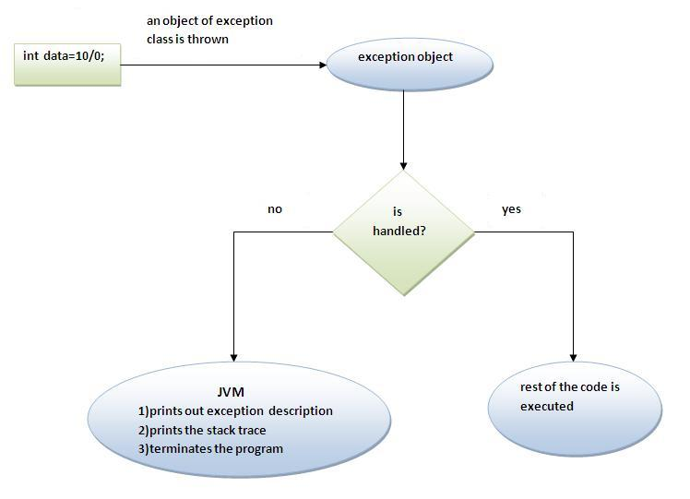
Internal working of java try-catch block

Slide 11
Java Multi catch block
If you have to perform different tasks at the occurrence of different Exceptions, use java multi catch block.
Let's see a simple example of java multi-catch block.

Slide 12
class TestMultipleCatchBlock1{
public static void main(String args[]){
try{
int a[]=new int[5];
a[5]=30/0;
}
catch(Exception e)
{System.out.println("common task completed");}
catch(ArithmeticException e)
{System.out.println("task1 is completed");}
catch(ArrayIndexOutOfBoundsException e)
{System.out.println("task 2 completed");}
System.out.println("rest of the code...");
}
}

Slide 13
Java Nested try block
The try block within a try block is known as nested try block in java.
Why use nested try block
Sometimes a situation may arise where a part of a block may cause one error and the entire block itself may cause another error. In such cases, exception handlers have to be nested.

Slide 14
Syntax:-
try
{
statement 1;
statement 2;
try
{
statement 1;
statement 2;
}
catch(Exception e)
{
}
}
catch(Exception e)
{
}

Slide 15
class Excep6
{
public static void main(String args[]){
try{
try{
System.out.println("going to divide");
int b =39/0;
}catch(ArithmeticException e){System.out.println(e);}
B
try{
int a[]=new int[5];
a[5]=4;
}
catch(ArrayIndexOutOfBoundsException e)
{System.out.println(e);}
System.out.println("other statement);
}catch(Exception e){System.out.println("handeled");}
System.out.println("normal flow..");
}
}

Slide 16
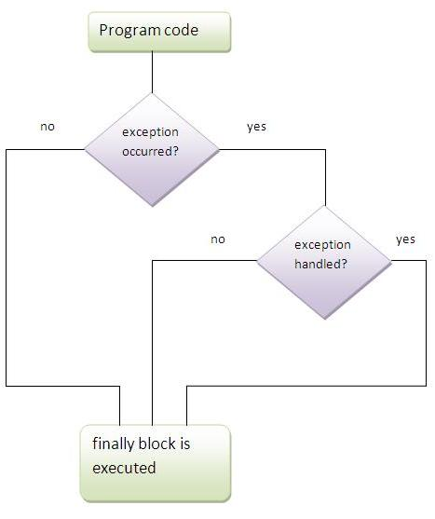
Java finally block
Java finally block is a block that is used to execute important code such as closing connection, stream etc.
Java finally block is always executed whether exception is handled or not.
Java finally block follows try or catch block.

